Slide 1

Research Progress Monitoring-October 2023
Title: Explainable AI-Based Early Severe Dengue Prediction using Hematological and Clinical Data
Supervisor: Mohammad Arif Hasan Chowdhury, Assistant Professor
Students:
Md. Aftabul Islam – 22070103
Mohammad Mazharul Alam - 22070116
Year & Semester: 4th Year 8st Semester

Slide 2

Presentation Outline
1- Introduction & Background
2- Research Objectives
3- Methodology
4- Work Done
6- Research Schedule
5 -Work Planned
Estimated Presentation Time:
10 - 12 minutes

Slide 3
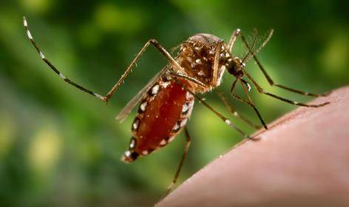
Introduction & Background
Dengue fever remains a critical global health threat, often progressing to severe stages like shock if not detected through early diagnostic indicators.
Traditional clinical triage relies on static parameters, creating a need for intelligent predictive systems that can interpret complex hematological shifts.
This research presents an explainable machine learning approach to bridge the gap between black-box AI and clinical diagnostic trust for severe cases.

Slide 4
Research Objectives
To develop a robust ensemble-based predictive model that identifies patients at high risk of dengue shock syndrome using baseline clinical and lab data.
To implement Explainable AI (XAI) using SHAP, providing clinicians with interpretable visual insights into the key symptoms driving specific patient risk scores.
To create an interactive real-time dashboard that forecasts platelet nadir and severity risk, enabling early intervention and optimized hospital resource management.

Slide 5
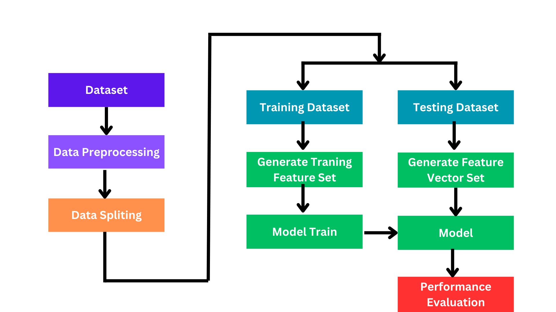
Methodology

Slide 6
Progress (Work Done)

Slide 7
Model
Here I run 3 of this model
Decision Tree
Random Forest
K-Nearest-Neighbors

Slide 8
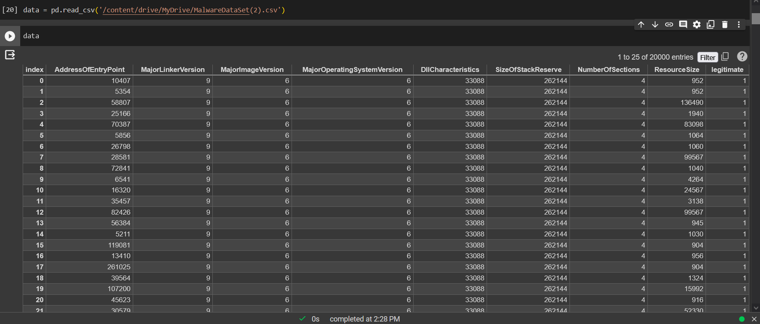
Dataset

Slide 9
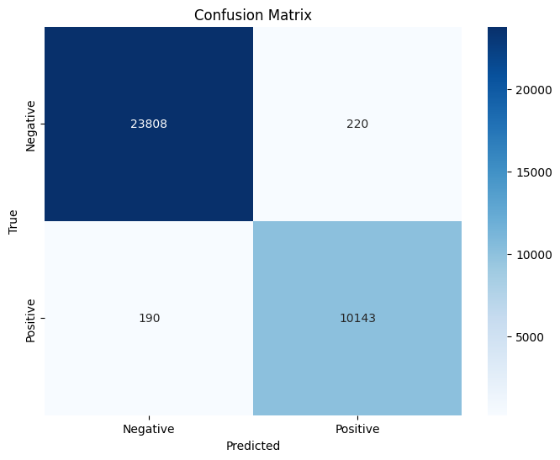
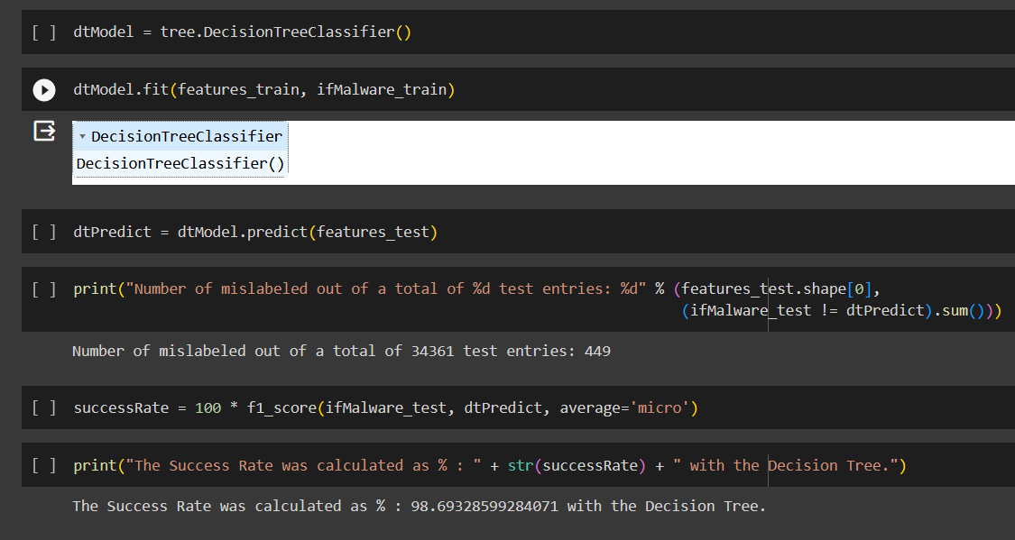
Decision Tree
Model Train
Confusion Matrix

Slide 10
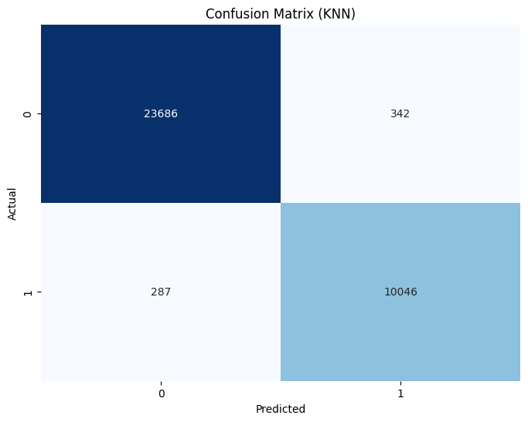
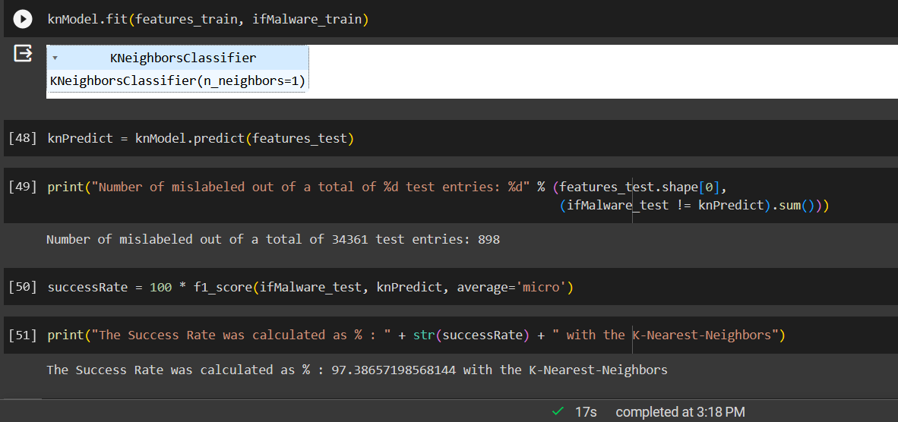
K-Nearest-Neighbors
Model Train
Confusion Matrix

Slide 11
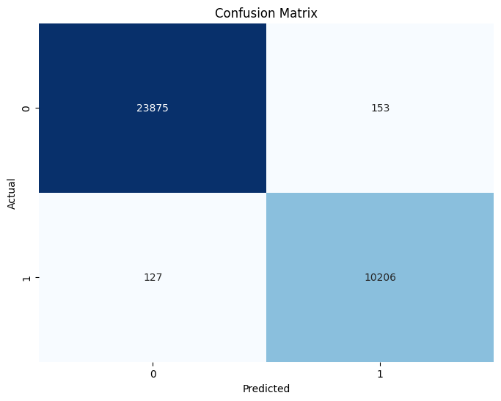
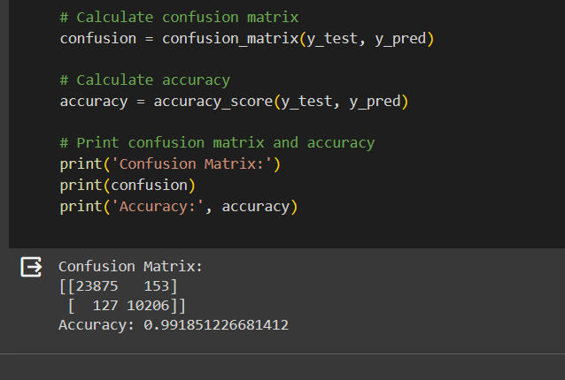
Random Forest
Model Train
Confusion Matrix

Slide 12
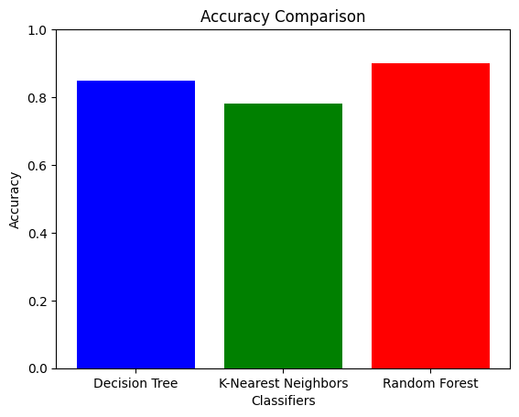
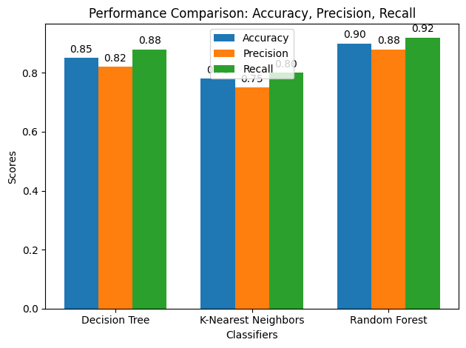
Performance Comparison
Accuracy Comparison
Performance Comparison

Slide 13
Thesis Completion
1) How much have been achieved?
After studying various research papers and works of literature review, I learned about Various Models of machine learning.
Collect the dataset from GitHub
Completed training dataset using Decision Tree, K-Nearest-Neighbors , Random Forest algorithm.
2) What are the obstacles or difficulties faced?
Data collection and paper downloading, because many of the dataset and papers are paid versions so I just have a problem collecting a recent dataset and papers.
Increasing accuracy, here I just trained 3 model decision tree, K-Nearest-Neighbors and the random forest they didn't give me a better output so I tried to find the best one
3) Earliest possible completion date?
The rate we are going, we can possibly finish our thesis and others within December , 2023

Slide 14
Work Planned
Title Time | Oct 2022 | Nov 2022 | Dec 2022 | Jan 2022 | Feb 2022 | Mar 2022 | Apr 2022 | May 2023 | Jun 2023 | Jul 2023 | Aug 2023 | Sep 2023 | Oct 2023 | Nov 2023 | Dec 2023
Thesis topic selection
Literature Review
Research on Methodology
Data Collection
Data Analysis
Train Model (running)
Model Optimization (running)
System Development (Pending)
Thesis Writing (Pending) |  |  |  |  |  |  |  |  |  |  | Chapter 1&2 | Chapter 1&2

Slide 15
References
[1] Metaheuristics With Deep Learning Model For Cybersecurity And Android Malware Detection And Classification, Ashwag Albakri , Department Of Computer Science, College Of Computer Science & Information Technology, Jazan University, Jazan 45142, Saudi Arabia , Published : 8 February 2023. [2] Malware Detection Using Deep Learning And Correlation-based Feature Selection , Esraa Saleh Alomari , Riyadh Rahef Nuiaa , College Of Education For Pure Sciences, Wasit University, Al-kut 52001, Iraq , Published : 1 January 2023 . [3], Juan A. Herrera-silva , Myriam Hernánddynamic Feature Dataset For Ransomware Detection Using Machine Learning Algorithms Ez-álvarez , Ladrón De Guevara E11-25 Y Andalucía, Edificio De Sistemas, Quito 170525, Ecuador, Published : 17 January 2023. [4] Malware Detection Using Machine Learning , Dragos¸ Gavrilut , Faculty Of Computer Science, “Al. I. Cuza” University Of Ias¸i, Romania, Published : 2 February 2023

Slide 16
Thank you
Q&A

